Slide 1
ADVANCED MACHINE LEARNING • PROJECT PRESENTATION
NYC Air Corridor 2013
Predicting Flight Delays the Night Before
Leakage-free feature engineering, calibrated classifiers, and what-if rescheduling across 336k departures.
CORE FOCUS
DATASET
MODELS
Strict Day-Ahead Operational Decision Boundary
EWR • JFK • LGA
Logistic Regression • XGBoost

Slide 2

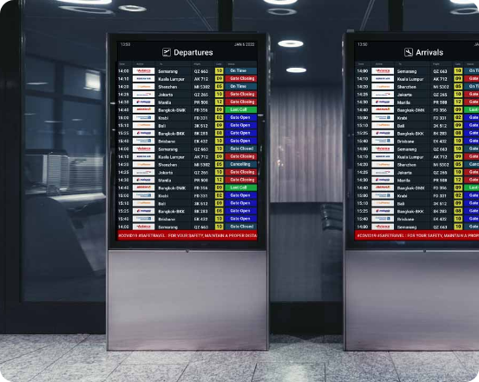
01 / OPERATIONAL CHALLENGE
The Real-World Decision Boundary
The Core Question
Can we reliably flag flights landing 15+ minutes late before operations begin tomorrow?
The Common Pitfall
Most academic benchmarks use departure delays (corr = 0.915) or live gate data. This leaks the future.
Our Strict Rule
Use only published schedule metrics and prior-day history available by 23:59.

Slide 3
02 / EXPLORATORY DATA ANALYSIS
Delay Dynamics Across 336,776 Flights
10% → 37%
0.40
18% vs 34%
Cascade Effect
Lag-1 Autocorrelation
Severe Seasonality
Evening flights absorb cumulative aircraft rotation delays.
Disruption carries over to tomorrow, then drops sharply to 0.13.
Fall months are peaceful; December winter peaks in disruption.
Note: 9,430 cancelled or diverted flights excluded from target training, but preserved for advance schedule congestion counts.

Slide 4




03 / FEATURE ENGINEERING
35 Engineered Clues Built Past-Only
Calendar & Cyclic
Traffic & Congestion
Smoothed History
Automated Test
Continuous sin/cos time encodings, day of week, and holiday distance.
Scheduled departures per origin-day, hourly volume, and rotation leg.
Route, carrier, and aircraft past rates shrunk with Beta(m=20) prior.
Verified: scrambling future outcomes does not alter past features.
Design Rule: Month and Day-of-Year features were strictly removed to prevent tree models from memorizing specific calendar days.

Slide 5
04 / EXPERIMENTAL DESIGN
Strict Chronological Evaluation
PHASE 2 • VALIDATION
PHASE 3 • TEST
PHASE 1 • TRAINING
Oct – Nov
December
January – September
55,589 flights • Rate: 17.8%
27,020 flights • Rate: 33.5%
244,737 flights • Base delay rate: 25.0%
Crucial Regularization Finding in XGBoost
With default leaves, XGBoost memorized days via constant daily features. Setting min_child_weight = 2000 forced leaves to cover ≥8,000 flights (~9 days of NYC traffic), stopping memorization.
Zero data peeking: all model parameters, thresholds, and calibrators were selected strictly on validation months.

Slide 6
05 / MODEL DISCRIMINATION
Significant Uplift Above Baseline
XGBoost (Selected Tuned Model)
PR-AUC: 0.468 | ROC-AUC: 0.645
Logistic Regression (L2 Regularized)
PR-AUC: 0.461 | ROC-AUC: 0.640
Route History Baseline
PR-AUC: 0.381 | ROC-AUC: 0.554
Prior Base Rate Guessing
PR-AUC: 0.335 | ROC-AUC: 0.500
Both classifiers outperform route history by +22% in PR-AUC on held-out December.
Unobservable day-level weather sets the upper ceiling on ROC-AUC (~0.65).

Slide 7
06 / OPERATIONAL DECISIONS
Enforcing High Precision Thresholds
The Precision Constraint
Airlines cannot afford high false alarms. Operating points required ≥50% precision on validation.
66.1%
The Recall Trade-Off
Validated Precision Target
Under fixed calibration, recall was only 3.5% (flags 1.8% of flights) because December was severe.
When XGBoost flags a flight as high risk, 2 out of 3 flights are genuinely delayed 15+ minutes.
Actionable Scope
Enables high-conviction alerts for dispatchers rather than broad uncertain warnings.
Operating threshold fixed at 0.498 from validation metrics; applied cold to December test set.

Slide 8
07 / RELIABILITY & LABEL SHIFT
Solving the Seasonal Calibration Drift
THE BREAKDOWN
THE SOLUTION
Fixed Platt Scaling
Rolling 28-Day Recalibration
Calibrators fitted on calm Oct-Nov (17.8% delays) systematically under-predicted stormy December (33.5%).
Refitting daily on previous 4-week realized outcomes tracks environmental drift dynamically.
ECE: 0.102
ECE: 0.047
Mean predicted risk dropped to 23.4%
Halved calibration error; recall rose to 6.2%
Practical takeaway: Risk models in seasonal transportation require rolling posterior recalibration.

Slide 9
08 / PRESCRIPTIVE SIMULATION
Can We Reschedule High-Risk Flights?
Risk Threshold | Flagged Flights | Observed Late | Moved (±2h) | Risk Before → After
p ≥ 0.40 | 5,750 | 47.4% | 295 | 0.504 → 0.444
p ≥ 0.50 (Primary) | 1,979 | 52.0% | 133 (98 moved earlier) | 0.571 → 0.510
p ≥ 0.60 | 473 | 55.6% | 33 | 0.657 → 0.595
Simulation Takeaway: Moving flights earlier (-2h) yields small risk reductions. However, systemic delay risk is anchored primarily to day-level conditions and route congestion rather than the departure hour alone.

Slide 10


09 / CRITICAL ASSUMPTIONS
Model Boundaries & Constraints
1. Weather Data Cap
Day-level storm systems explain core variance. Without day-ahead forecast ingestion, ROC-AUC caps at ~0.65.
2. Single-Year Corridor Scope
Only NYC departures in 2013: inbound rotation legs into NYC remain unobserved.
3. Associational Rescheduling
What-if re-timing ignores crew duty time limits, gate constraints, and passenger connection banks.
Acknowledging constraints strengthens experimental credibility during presentation defense.

Slide 11




10 / CONCLUSION & ROADMAP
Phase 1 Key Takeaways
Zero-Leakage Soundness
Model Equivalence
Adaptive Recalibration
Phase 2 Direction
Strict temporal split and automated leakage tests guarantee deployable, honest predictions.
LR (0.461) and XGBoost (0.468) perform similarly once boosting tree leaves are properly regularized.
A rolling 28-day window overcomes seasonal base-rate shifts, cutting probability error in half.
Next step: Compact Multi-Layer Perceptron (MLP) learning entity embeddings for carriers and airports.
All code, models, and reproducible notebooks are cataloged on GitHub.

Slide 12

Thank You
Day-ahead flight delay risk prediction with leakage-free features and rolling probability calibration.
Open for Questions & Discussion
Repository: github.com/techatanu/Flight_Delay_Risk

